Slide 1
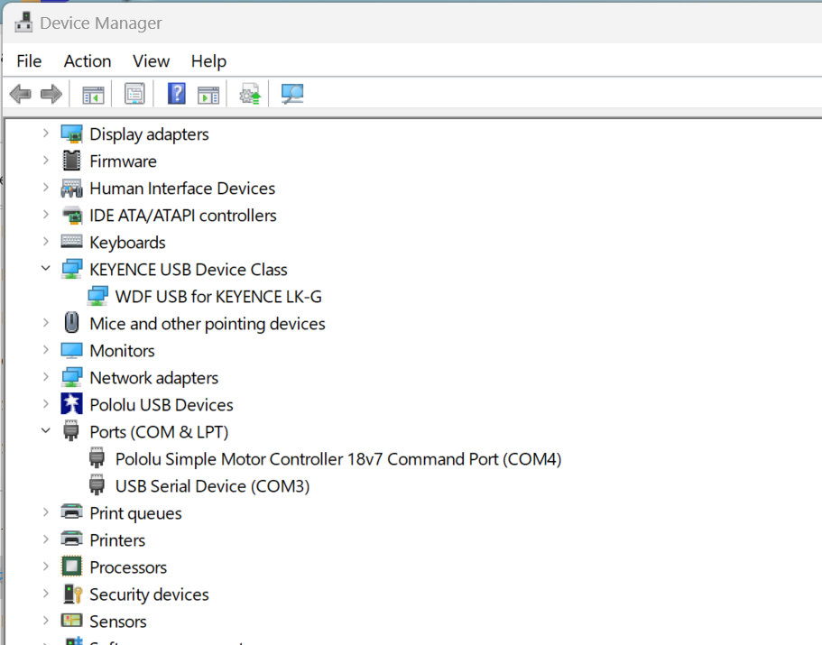
Maker sure USB hub power is ON Then
In Device Manager, make sure you have
Keyance LK-G
Pololu MC 18v7 (COMX)
USB Ser Device (COMY) -- DataQ

Slide 2
Pololu MC18V7
Nomimnal 24 Vdc @ 7A Vin Max is 30Vdc.
After installing the drivers, if you go to your computer’s Device Manager and expand the “Ports (COM & LPT)” list, you should see a COM port for the Simple Motor Controller. In parentheses after the name, you will see the name of the port (e.g. “COM5” or “COM6”).
You might see that the COM port is named “USB Serial Device” in the Device Manager instead of having a descriptive name. This can happen if you are using Windows 10 or later and you plugged the Simple Motor Controller into your computer before installing our drivers for it. In that case, Windows will set up your Simple Motor Controller using the default Windows serial driver (usbser.inf), and it will display “USB Serial Device” as the name for the port. The port will be usable, but it might be hard to distinguish the port from other ports because of the generic name shown in the Device Manager. We recommend fixing the name in the Device Manager by right-clicking on the “USB Serial Device” entry, selecting “Update Driver Software…”, and then selecting “Search automatically for updated driver software”. Windows should find the Simple Motor Controller drivers you already installed, which contain the correct name for the port.
If you want to change the COM port number assigned to your USB device, you can do so using the Device Manager. Bring up the properties dialog for the COM port and click the “Advanced…” button in the “Port Settings” tab. From this dialog you can change the COM port assigned to your device.

Slide 3
